Slide 1
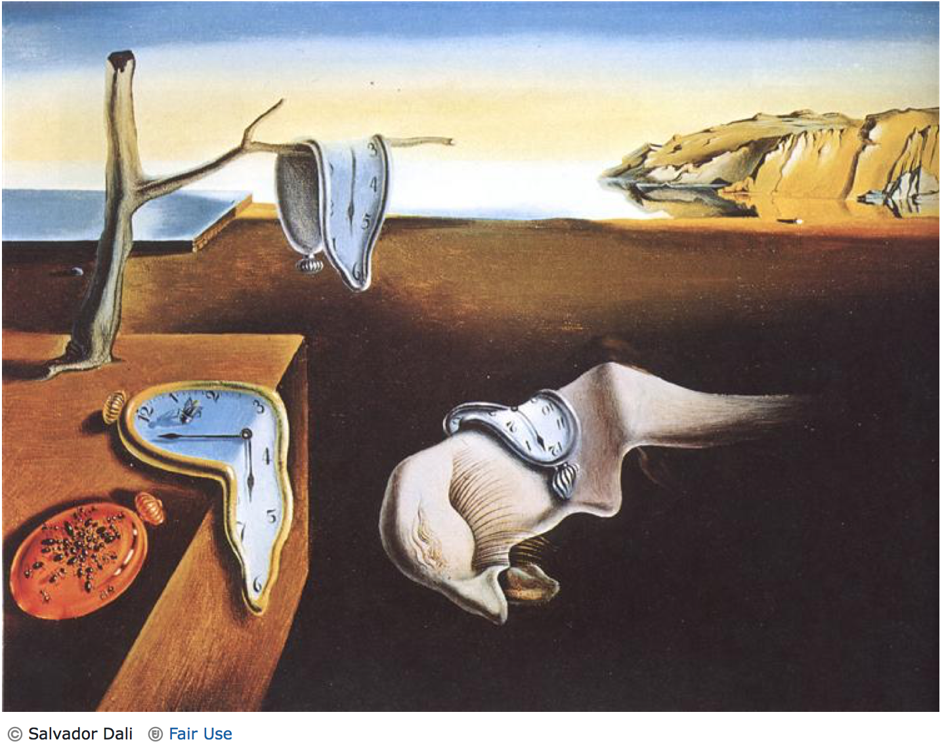
Molecular clocks, Gene Trees and Species Trees
Genomics of Disease in Wildlife Workshop
Colorado State University
June 3-11, 2017
Slatteryjp@si.edu
Jill.Pecon-Slattery@colostate.edu
www.cornerstonegenomics.com
http://gdwworkshop.colostate.edu
Notes:
Roman Biek
Yersina refs
Chlamydia refs

Slide 2
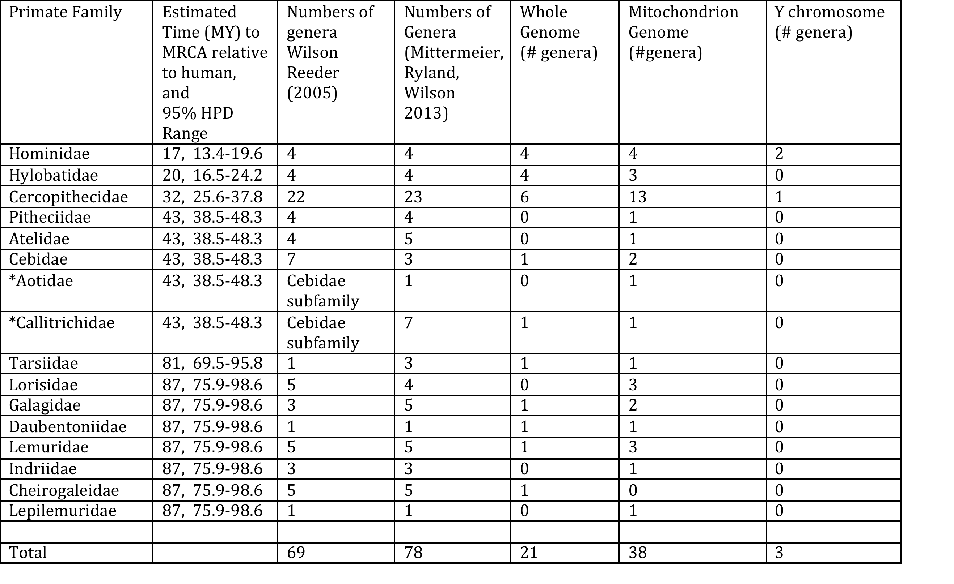
Estimation of TMRCA

Slide 3
Definitions
Gene tree-geneological history of the gene or gene family over time.
Species tree-geneological relationships of species from which genes were sequenced
Molecular Clock-genetic divergence is roughly proportional to evolutionary time
Concatenation methods-A single sequence per taxon that is a composite of multiple gene regions selected across the genome.
Incomplete lineage sorting-evolutionary history of genes are discordant with patterns of speciation.
Multi-Species Coalescent methods-individual gene tree are simultaneously or separately estimated and then a summation method to ascertain phylogenetic relationships.

Slide 4
Advances in Molecular Dating Methods
Notes:
Strict

Slide 5
Strict Molecular Clock
The hypothesis that the rate of molecular evolution is constant over time or among species. Thus, mutations accumulate at a uniform rate after species divergence, keeping time like a timepiece.

Slide 6
Relaxed Molecular Clock and Bayesian Methods
Models of evolutionary rate drift over time or across lineages developed to relax the molecular clock hypothesis.
The parameters are the species divergence times (t) and the evolutionary rates (r) within a Bayesian model.

Slide 7
Time-Tree: Dating Nodes Within Molecular Genomic Phylogeny
Testing for Molecular Clocks
Strict: substitution rate the same for all branches of topology
Relaxed: Heterogeneous substitution rates are permitted with different branches of topology
Time-Tree estimation with Bayesian framework is computationally prohibitive with large scale genomic sequence data
Solution is to select subsets of data
genes, species or both
Codon position (1st and 2nd)
Hierarchical lineages within phylogeny
Assess sample strategy by testing for consistent rates across lineage
Calibration: Multiple fossil record (host) or known date(s) linked with pathogen
Iterative subsampling to converge on dates for nodes

Slide 8
Bayesian Programs to Estimate Molecular Clock

Slide 9
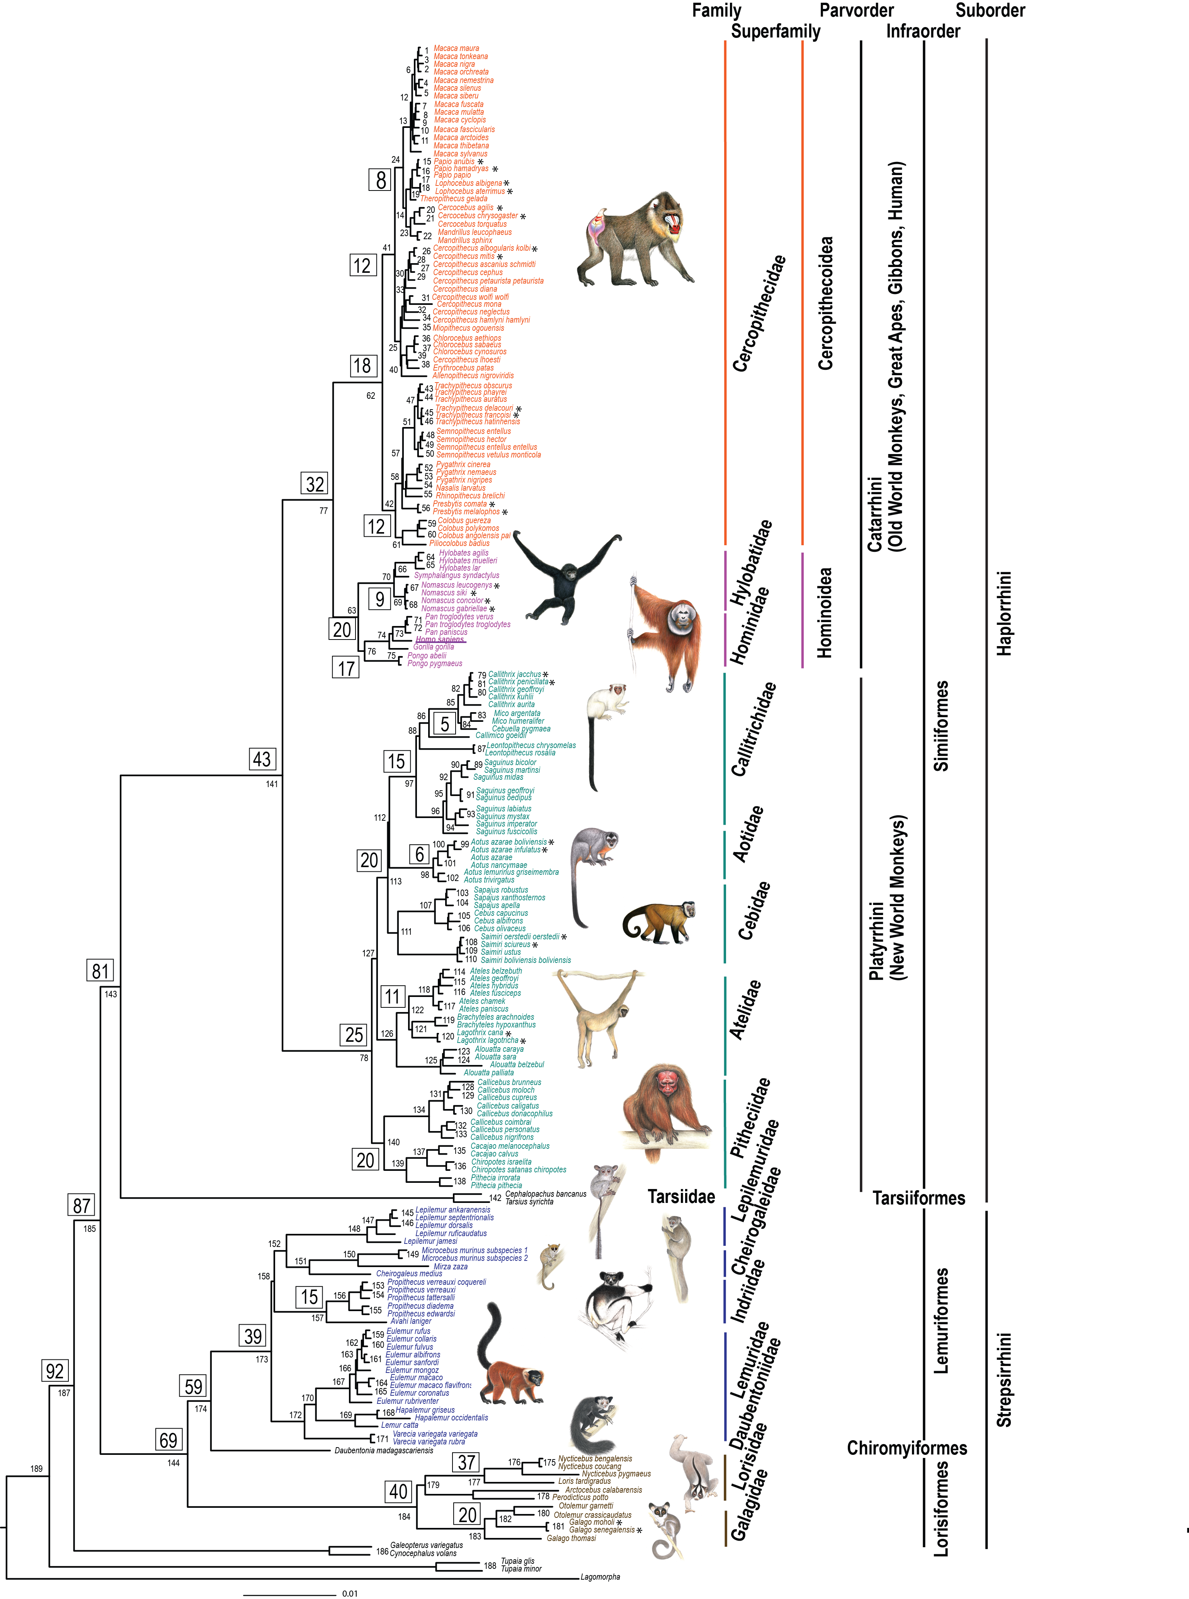
DATING NODES (BEAST)
Calibrated by fossil record: Strong support from consensus of paleoanthropologist with extensive citation record per dates
A Galigidae-Lorisidae split 38-42 MYA
B Simiiformes 36-50 MYA
C Catarrhini 20-38 MYA
D Platyrrhini 20-27 MYA
E Papionini 6-8 MYA
F Theropithecus 3.5-4.5 MYA
G Hominidae 13-18 MYA
H Homo-Pan split 6-7 MYA
5 Different Sets Of Species (BEAST):
1) Genus-level data set including 61 Primate genera, two Dermoptera genera and one Scandentia genus rooted by Lagomorpha,
2) Catarrhini species with outgroups, 3) Platyrrhini species with outgroups,
4) Strepsirrhini species with outgroups and
5) Genus-level analysis with a partitioned data set allowing for rate heterogeneity and different substitution models for autosome, X-chromosome, and Y-chromosome sequences.
Notes:
We estimated the phylogeny and divergence time splits simultaneously using a Bayesian approach as implemented in the program BEAST ver 1.5.3 [76], [77]. Due to computational constraints, analyses were performed with 5 different sets of species: 1) genus-level data set including 61 Primate genera, two Dermoptera genera and one Scandentia genus rooted by Lagomorpha, 2) Catarrhini species with outgroups, 3) Platyrrhini species with outgroups, 4) Strepsirrhini species with outgroups and 5) genus-level analysis with a partitioned data set allowing for rate heterogeneity and different substitution models for autosome, X-chromosome, and Y-chromosome sequences.
By using the uncorrelated lognormal relaxed-clock model, rates were allowed to vary among branches without the a priori assumption of autocorrelation between adjacent branches. This model allows sampling of the coefficient of variation of rates, which reflects the degree of departure from a global clock. Based on the results of ModelTest, we assumed a GTR+I+G model of DNA substitution with four rate categories. Uniform priors were employed for GTR substitution parameters (0, 100), gamma shape parameter (0, 100) and proportion of invariant sites parameter (0, 1). The uncorrelated lognormal relaxed molecular clock model was used to estimate substitution rates for all nodes in the tree, with uniform priors on the mean (0, 100) and standard deviation (0, 10) of this clock model. We employed the Yule process of speciation as the tree prior and a Unweighted Pair Group Method with Arithmetic Mean (UPGMA) tree to construct a starting tree, with the ingroup assumed to be monophyletic with respect to the outgroup. To obtain the posterior distribution of the estimated divergence times, nine calibration points were applied as normal priors to constrain the age of the following nodes (labeled A-H in Figure 1 of main text): A) mean = 40.0 MYA, standard deviation (stdev) = 3.0 for time to most recent common ancestor (TMRCA) of galagids and lorisids [78], B) mean = 43.0 MYA, stdev = 4.5 for TMRCA of Simiiformes [79], [80], C) mean = 29.0 MYA, stdev = 6.0 for TMRCA of Catarrhini [80], D) mean = 23.5 MYA, stdev = 3.0 for TMRCA of Platyrrhini [26], [81], E) mean = 7 MYA, stdev = 1.0 for TMRCA of Papionini [82], F) mean = 4.0 MYA, stdev = 0.4 for TMRCA of Theropithecus clade [40], [83], G) mean = 15.5 MYA, stdev = 2.5 for TMRCA of Hominidae [14] and H) mean = 6.5 MYA, stdev = 0.8 for TMRCA of Homo-Pan [84]. A normal prior for the mean root height of 90.0 MYA with stdev = 6.0 was used based on molecular estimates of MRCA of all Primates [14], [82], [85]. The calibration points selected are based on fossil dates that have undergone extensive review in previous publications and are supported by a consensus of paleoanthropologists. Rather than re-iterate the considerable amount of information forming the basis for each calibration point, we list the respective citations with the most detailed overview and attendant references.
Four to seven independent Markov chain Monte Carlo (MCMC) runs for each analysis were run for 20–100 million generations to ensure sampling of estimated sample size (ESS) values. The Auto Optimize Operators function was enabled to maximize efficiency of MCMC runs. Trees were saved every 1000 generations. Log files from each run were imported into Tracer ver 1.4.1, and trees sampled from the first 1 million generations were discarded. Mixing of trees was assessed in Tracer by examination of ESS values. Analysis of these parameters in Tracer suggested that the number of MCMC steps was more than adequate, with ESS of all parameters often exceeding 200, and Tracer plots showing strong equilibrium after discarding burn-in. Tree files from the individual runs were combined using LogCombiner ver 1.5.3 after removing 1000 trees from each sample. The maximum-clade-credibility tree topology and mean node heights were calculated from the posterior distribution of the trees. Final summary trees were produced in TreeAnnotator ver 1.5.3 and viewed in FigTree ver 1.3.1.How did we do this?

Slide 10
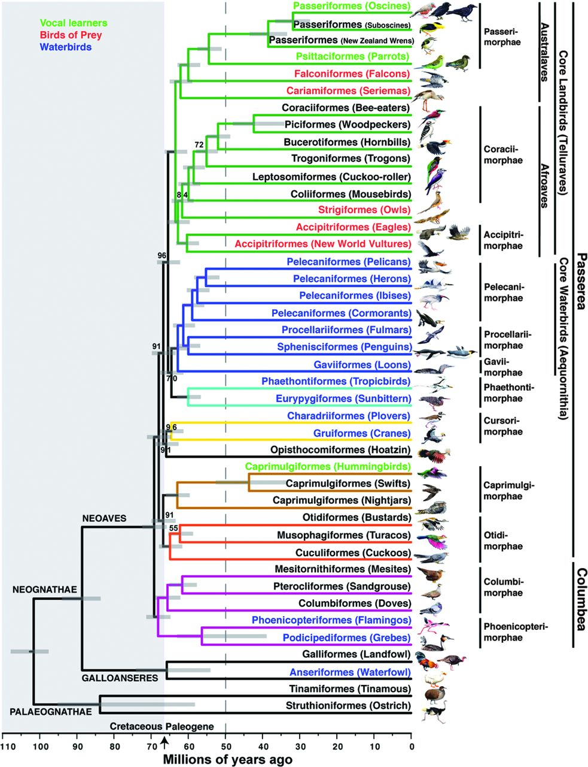
Selection Criteria
39 Fossil Calibration Points
Increases from root, oldest to youngest
Literature reference, citation, supporting documentation
Taxonomic description
Stratigraphic range of fossil taxon
Parts of skeleton used for fossil date
Erich D. Jarvis et al. Science 2014;346:1320-1331
Notes:
From jarvis and birds:
Although introns can infer a tree closer to the species, we used clocklike exons, because our analysis of the 2516 conserved orthologous introns revealed widespread and substantial departures from clocklike evolution. Non-clock like rate heterogeneity among lineages can cause considerable difficulty for molecular dating, especially when the patterns of variation differ among loci (182). Using clocklike exons allows us to avoid the problem we found with tree inference using high variance exons. Further, since we only included the first and second codon positions of the clocklike exons, we use data that give a topology closer to the total evidence 36
data. The third codon positions of the high variance genes were the main source of the problems in using exon sequences for estimating the tree topology. Despite the differences in the tree topologies with different data sets, when we performed dating analyses on them, all, including the c123 tree with the biased high variance exons, yielded very similar results with regard to the timing of the Neoaves radiation as well as other nodes of interest in the tree. Thus, we do not believe that the reliance on the clock-like exons caused an error in the dating.
Our numbering for fossil calibrations (Table S15 and below) increases as consecutively as possible up the avian tree from its root, from oldest to youngest. Each calibration includes a heading to define its position on the TENT tree and its age. This is followed by designation of a higher taxon to which the reference fossil has been assigned or can be confidently assigned. This in turn is followed in each case by: a) in boldface italics the reference fossil species used for the calibration and the citation in ( ) of its taxonomic description; b) if warranted, citation of additional relevant papers describing reinterpretation of the reference fossil or additional fossil material; c) the stratigraphic range of the taxon with citation if warranted; and d) the parts of the skeleton from which the fossil is known. Under the same numbered calibration heading, some have additional fossil evidence that tentatively suggest temporal range extensions or provide additional support for the calibration.
To estimate the timescale of avian evolution and diversification, we first identified a subset of the 8,295 orthologs that has undergone clocklike evolution (constant evolutionary rate among lineages). This was done by analyzing the 1st and 2nd codon positions of each alignment using an uncorrelated lognormal relaxed clock (179) in the Bayesian phylogenetic software BEAST v1.7.2 (180, 181). This relaxed-clock model produces a coefficient of variation (CoV) of rates, which measures the degree of rate heterogeneity among lineages. A value of 0 reflects rate homogeneity among lineages (a strict molecular clock), whereas values >1 indicate a large degree of rate heterogeneity among lineages. Orthologs were selected for the dating analyses when the mean estimate of the CoV was less than 0.5 and the lower and upper limits of the 95% credibility interval of the CoV were less than 0.1 and 1.0, respectively. These criteria were satisfied by 1156 orthologs (722,202 nucleotides).
Bayesian dating analysis was conducted using a concatenated alignment comprising the 1st and 2nd codon positions of the 1156 orthologs selected in the previous step. The tree topology was fixed to each of different species trees that were estimated in this study, with a focus on the ExaML TENT tree (Fig. S1). Divergence times were estimated using the autocorrelated and uncorrelated relaxed clocks in MCMCTREE in PAML 4.6 (77). Both types of relaxed clock methods produced similar date estimates; results from the autocorrelated method are reported in this study. We used the HKY85+GAMMA model of nucleotide substitution, with four rate categories for gamma-distributed rates across sites. Due to the very large size of the dataset, we used the approximate-likelihood method with branch lengths estimated using maximum-likelihood in the PAML program baseml. We also examined the effects of varying the gamma prior for the overall rates for genes (rgene_gamma) and found that our date estimates were robust to changes in this prior.
Posterior distributions of divergence times were estimated by Markov chain Monte Carlo sampling, with samples drawn every 2000 steps over a total of 108 steps after a discarded burn-in of 2107 steps. To check for convergence to the stationary distribution, each analysis (including the baseml step) was run in duplicate and the results were compared between runs.

Slide 11
Saturation of Sites Or Incomplete Fossil Record?
Notes:
An infinite-sites plot can be used to deter- mine whether the amount of sequence data is satur- ated or whether including more sequence data is likely to improve the time estimates (FIG. 2). The theory has been extended to the analysis of large but finite data sets to partition the uncertainties in the posterior time
Here, the high correlation (R2 = 0.98) indicates that the amount of sequence data is very high, and the large uncertainties in the posterior time estimates are mostly due to uncertainties in the fossil calibrations; including more sequence data is unlikely to improve the posterior time estimates.

Slide 12
Time-Trees with Pathogen Genomes
Absence of pathogen fossils for calibration
Rates of genome evolution:
RNA viruses (fastest)
dsDNA viruses
Bacteria (slowest)
Inferences from temporal samples
Intra-host evolutionary rates
In general, the longer the residence time within host population or species, the greater the evolutionary divergence among strains.
Should take into account that greater the evolutionary time interval, the greater the opportunity for purifying selection, site saturation (multiple hits),to limit diversity (approaches the asymptote)

Slide 13
Pathogen Genome Evolutionary Rates

Slide 14
Relationship between nucleotide substitution rates and transmission events

Slide 15

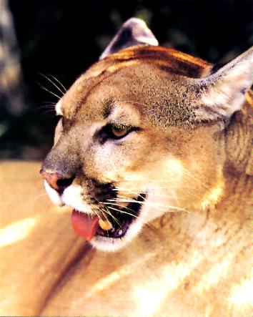
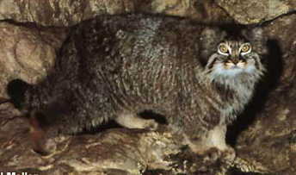
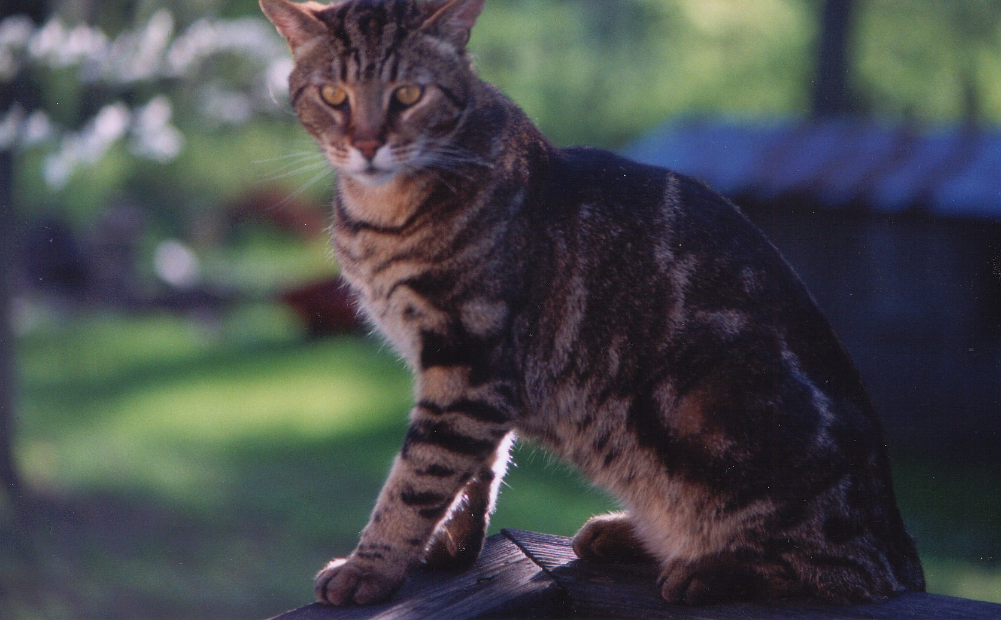
Divergence estimates across FIV genome reveal unequal rates, selection, and recombination
Pecon-Slattery et al 2008. BMC Genomics 9:66

Slide 16
Incomplete Lineage Sorting (ILS)
Incomplete lineage sorting occurs when gene trees do not reflect true species phylogeny (reciprocal monophyly). The genes, due to biological processes such as inter-species hybridization, introgression, reticulate evolution, or molecular processes (i.e mutation rate, recombination, or genome function), provide alternate topologies.
Characteristic in radiations characterized by short internal internode distances correlated with rapid diversification.
Usually nodes are weakly supported (<70%) with bootstrap values or Bayesian proportions (<0.9)
Concatenation studies tend to ignore these genes alternate topologies as it generates too much ‘noise’ or homoplasy (convergent, reversal, multiple hits)
However, recent studies particularly with humans and great apes indicate that these gene may have functional implications important in understanding species biology and/or adaptive evolution

Slide 17
Gene Tree and Species Tree Discordance

Slide 18
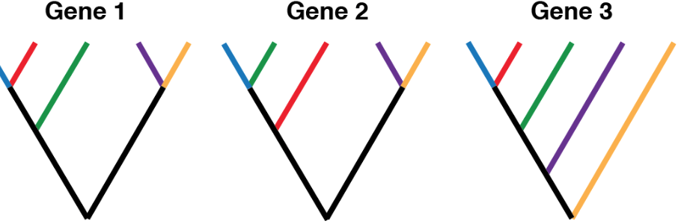
Discordance in Gene Trees: rate of substitution heterogeneity
Selection of marker should be informative for scale of evolution

Slide 19
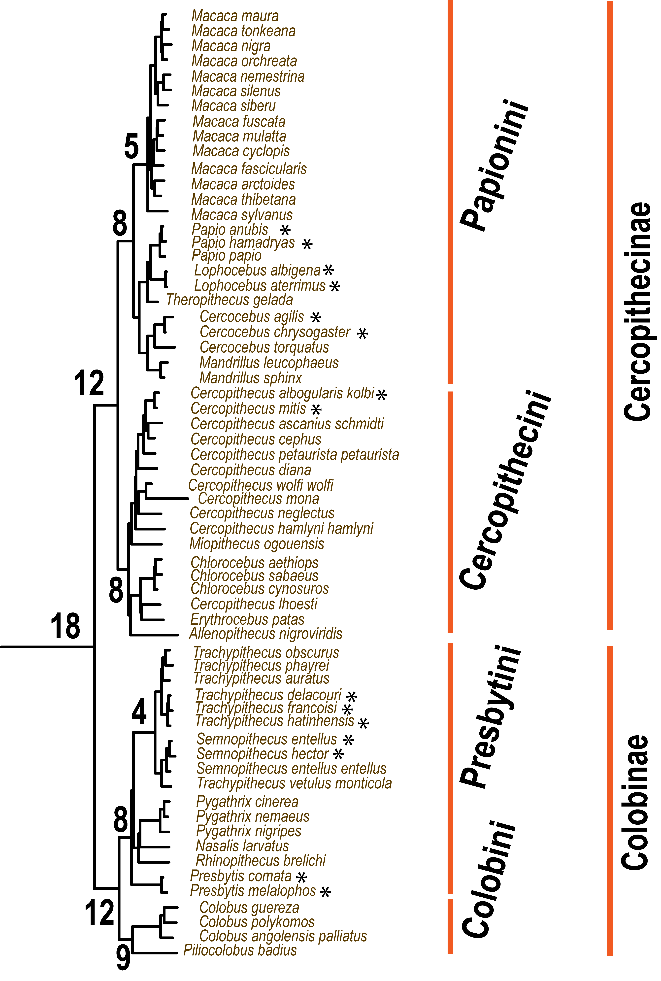
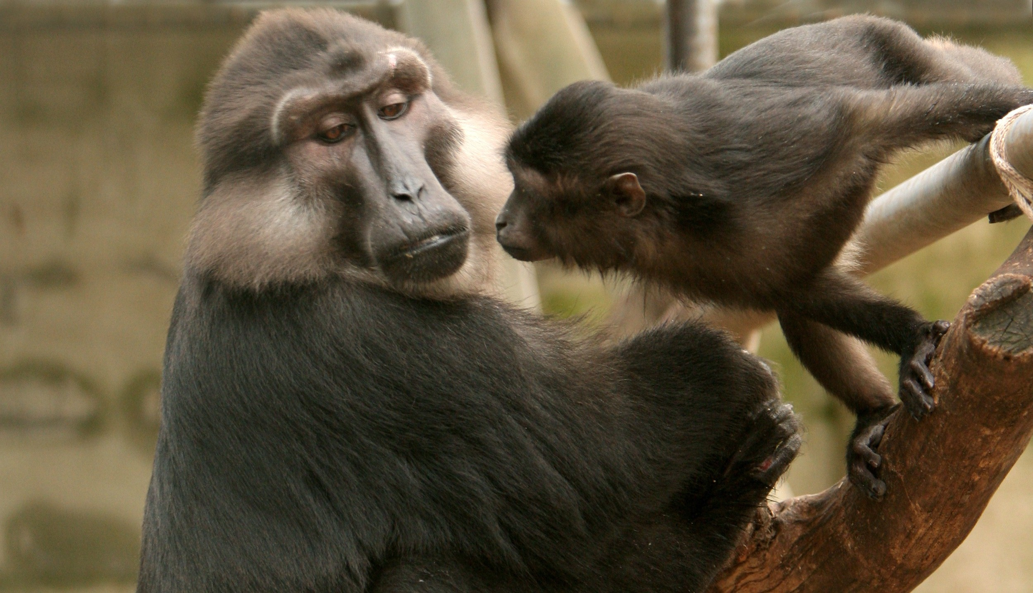
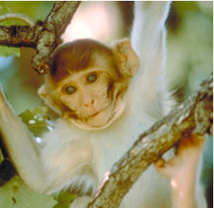
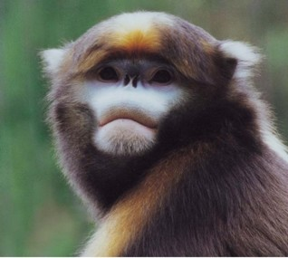
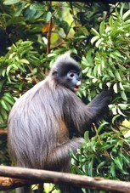
Cercopithecoidea: Old World Monkeys
Two Subfamilies
Cercopithecinae
macaques, baboons
Higher proportion of recent species (asterisk) < 1 MYA
Ongoing hybridization and introgression sympatric species
Colobinae:
Digestive adaptation to arboreal leaf eating existence
Asian and African tribes
Taxonomic revision of Trachypithecus, Presbytis, Semnopithecus
Notes:
Cercopithecoidea (family Cercopithecidae) speciation patterns are confounded by symplesiomorphic traits in morphology, behavior and reproduction, and are further confused by hybridization between sympatric species, subspecies and populations (summarized in [2]). Cercopithecidae includes two subfamilies, Colobinae and Cercopithecinae, which diverged 18 MYA (node 62), but classification schemes [2] are marked by inconsistencies between morphological [37,38] and genetic data, as well as differences among genetic data studies [4,27,39-44].
Colobinae radiation started approximately 12 MYA (node 42) with species adapted to an arboreal, leaf-eating existence. Asian (tribe Presbytini) and African (tribe Colobini) genera are monophyletic (nodes 53 and 61, respectively), supporting earlier genetic findings [4,40] over morphology-based taxonomy [2,45]. Whilst African genera Piliocolobus and Colobus are commonly recognized, the taxonomic schemes for the critically endangered Asian langur and leaf monkeys, all sharing digestive adaptations for an arboreal folivorous diet, have ranged from a single genus Presbytis to three distinct genera (Trachypithecus, Semnopithecus, Presbytis). Here, the Presbytis lineage, distinguished by 3 indel events (node 56), diverged first within Asian Colobinae, followed by the odd-nosed group (Rhinopithecus, Nasalis, Pygathrix), Trachypithecus and Semnopithecus. As odd-nosed species are not exclusively arboreal and folivorous, the results indicate either 1) morphological convergence between Presbytis with Trachypithecus and Semnopithecus, 2) adaptation for an expanded diet in the odd-nosed group, or 3) that a folivorous diet is a symplesiomorphic trait within Asian colobines.
Trachypithecus and Semnopithecus genera consist of closely related, often sympatric species (node 51), distributed in the Indian subcontinent and SE Asia, with inconsistent phylogenetic resolution among species [4,27,40,44,46]. Nonetheless, all genetic studies, including the present, place Trachypithecus vetulus (monticola) nested within the Semnopithecus clade (node 50), suggesting the need for taxonomic revision. Further, previously ambiguous associations between Trachypithecus and Semnopithecus (nodes 43-51) are clarified. Inter-specific genetic differences are roughly half those observed among other colobine genera (Figure 2, Figure S1, Table 3, Table S9) and may indicate that recent speciation, taxonomic over-splitting, reticulate evolution, or a combination thereof, (e. g. see [40,44,46]) are common within the Asian Colobinae radiation.
The remainder of Old World monkeys (tribes Papionini and Cercopithecini) [2] arose from a common ancestor approximately 11.5 MYA (node 41). Considerable interest in Cercopithecinae speciation is motivated not only by primate conservation, but increased biomedical surveillance for novel zoonotic agents and comparative research of host-pathogen adaptation relevant to the study of deadly human viral pandemics such as HIV/SIV.
Cercopithecini (guenons, patas monkey, talapoin, green monkeys) include lineages rooted by divergent monotypic genera followed by more recent speciation, characterized by transition from an arboreal to a terrestrial lifestyle. Generally arboreal, Miopithecus and Allenopithecus are early offshoots with respect to the two Cercopithecini subclades formed approximately 7 MYA. The Cercopithecus lineage (node 34) radiated after Miopithecus and retained an arboreal lifestyle. The second, rooted by Allenopithecus, forms a terrestrial clade of Erythrocebus patas and Chlorocebus species, with Cercopithecus l’hoesti separated the other Cercopithecus. This paraphyly, also reported in earlier genetic studies [39,47,48] and counter to initial morphological classifications [2], suggests taxonomic revision of Cercopithecus. Further, resolution of Allenopithecus (node 40) and Miopithecus (node 35) speciation herein suggests a single evoluiontary transition from an arboreal to a terrestrial lifestyle in E. patas, C. l’hoesti, and Chlorocebus species.
Papionini (macaques, mandrills, drills, baboons, geladas, mangabeys) is a taxonomically complex tribe [2]. One of the more familiar genera within Cercopithecoidea, Macaca (macaques) diverged 5.1 MYA and today is represented by an African lineage comprised of a single species M. sylvanus, and an Asian lineage consisting of well-defined species groups (fascicularis, sinica, mulatta, nemestrina, Sulawesi) inhabiting India and Asia, SE Asia and Sundaland [49]. With the exception of the fascicularis group, which is split in this study whereby M. arctoides [fascicularis] is more closely aligned with M. thibetana [sinica] rather than M. fascicularis as expected, our data otherwise strongly support these macaque species groups (nodes 6, 11). Moreover, the phylogeny affirms Groves [2] proposal that Lophocebus and Theropithecus are distinct clades apart from Papio (nodes 18, 19), although the average nucleotide divergence among these three genera are generally less than between other recognized Papionin genera (Macaca, Mandrillus, Cercocebus) (Figure 2, Figure S1, Table 3, Table S9). Lastly, sequence divergence between tribes is unequal with Cercopithecini nearly twice that of Papionini (mean branch length = 13.1, 7.43, respectively, p<0.005) and there are numerous instances of discordance between the present phylogeny with previous mtDNA studies [4,5] suggesting that continued resolution of Cercopithecinae speciation and of Papionini in particular, will likely include evidence of reticulate evolution represented by ongoing and historic episodes of hybridization (e.g. see [39,48]).

Slide 20
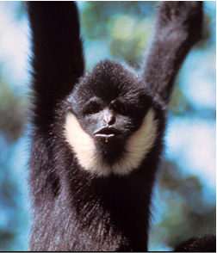
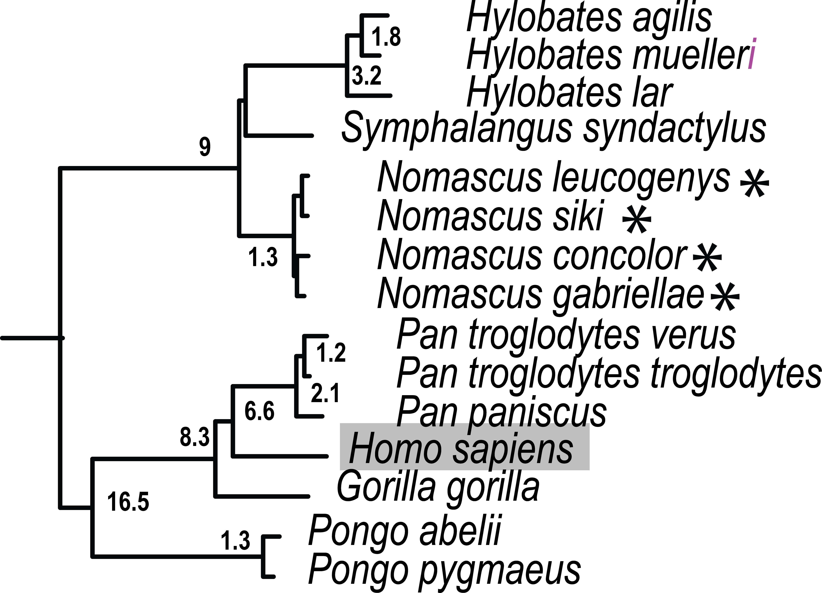
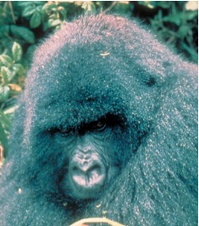
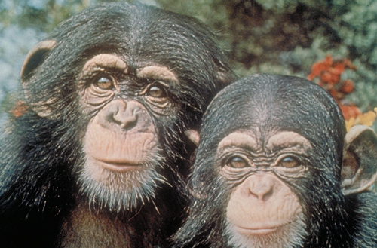
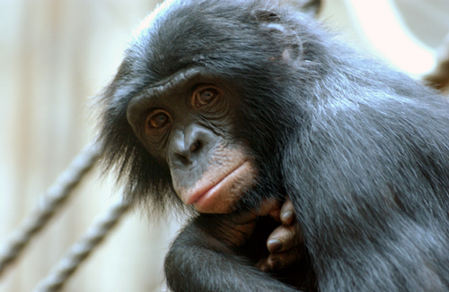
Hominoidea: Great Apes, Human, Gibbons
Hylobatidae:
Siamang, gibbon, hoolock
Exceptional rates of chromosome re-arrangement.
Each of 4 genera defined by different numbers of chromosomes.
Diverged rapidly from each other
Hominidae:
The largest primate Gorilla
Who is closest relative, Pan troglodytes or Pan paniscus?
20
Notes:
Once contentiously debated, the closest human relative of chimpanzee (Pan) within subfamily Homininae (Gorilla, Pan, Homo) is now generally undisputed. The branch forming the Homo and Pan lineage apart from Gorilla is relatively short (node 73, 27 steps MP, 0 indels) compared with that of the Pan genus (node 72, 91 steps MP, 2 indels) and suggests rapid speciation into the 3 genera occurred early in Homininae evolution. Based on 54 gene regions, Homo-Pan genetic distance range from 6.92 to 7.90 x 10-3 substitutions/site (P. paniscus and P. troglodytes, respectively), which is less than previous estimates based on large scale sequencing of specific regions such as chromosome 7 [50]. The highly endangered orangutan forms the single genus Pongo in subfamily Ponginae (nodes 75-76), the sister lineage to Homininae. Currently restricted to the islands of Borneo and Sumatra, orangutans once inhabited all of Southeast Asia during the Pleistocene [51]. Differences in behavior, morphology, karyology, and genetic data between the two island populations [2] support the taxonomic designation as two separate species of Bornean (P. pygmaeus ) and Sumatran orangutans (P. abelii), and these designations are upheld by the data presented here.
Hylobatidae (siamang, gibbons, hoolock) are noted for exceptional rates of chromosome re-arrangement [52,53], 10-20 times faster than in most mammals [54]. Classification schemes of the 12 species range from two genera (Hylobates and Symphalangus) to four subgenera and/or genera (Hylobates, Nomascus, Symphalangus, Hoolock), defined by unique numbers of chromosomes [54,55]. The eight species included in this study form three clades that coincide with genus designation (absent is Hoolock; nodes 64-69) that diverged rapidly 8.9 MYA. Moreover, Nomascus species appear more recent than Symphalangus and Hylobates, with node divergence dates estimated at less than 1 MY (Table 3, Table S9, Figure 2). Thus, Hylobatidae exhibits episodes of rapid divergence perhaps related to excessive genome re-organization and warrants additional investigation.

Slide 21
Considerations in Bacteria Gene Trees and Species Trees
Phylogenomics based on ‘core genome’
Gene acquisition, deletion, repeat cycle over time
Role of plasmid Hypervariable regions in genome (e.g. chlamydia example)
Unique genes often have vital function in adaptation and host-specificity
Rates of horizontal gene transfer unknown over time.

Slide 22
Plasticity zone in Chlamydia psittaci linked with host-pathogen interactions
Notes:
Would not use for phylogenic dating, but clearly not good to ignore in terms of vital role in function.

Slide 23
Bacteria Phylogenomics-Recombination
Notes:
Create ‘genes’ that ignore recombination just reflect orthologus sequence.
Despite the importance of Chlamydia species as pathogens of
humans and animals, very little is known about the evolution of the
various strains. Attempts have been made to reconstruct the
phylogeny of Chlamydia using 16S ribosomal RNA genes [72], the
ompA gene [73], and multilocus sequence typing (MLST) genes [74].
However, these loci do not necessarily represent the true relation-
ships between strains, and with whole-genome data it is now possible
to establish these relationships accurately. A detailed phylogenetic
analysis based on whole-genome sequencing of clinical C. tracho-
matis strains revealed that genome data can improve the resolution of
chlamydial phylogeny and that analyses based on the ompA gene are
misleading [75]. The primary factor that generates the ompA gene
bias in phylogenetics is that this gene is constantly changing to
counter the effects of the immune system [76]. By contrast, MLST
schemes based on housekeeping genes that are under low selective
pressure accurately reflect genome phylogeny [75]. However, MLST
schemes are based on a small number of genes and only provide
limited resolution, which means that it is difficult to determine the
relationship between closely related strains. Genome comparisons
revealed that 560 genes are shared by all Chlamydia representatives,
which is one half of the genes encoded in the genome [77]. Therefore,
it is possible to increase the number of genes to be used in
phylogenetic analysis and, as more Chlamydia strains are sequenced,
further detailed phylogenetic analyses will be important to under-

Slide 24
Gene Gain and Loss with Pathogen Evolution
Alan Mcnally et al 2016. Add, stir, reduce: Yersinia species as a model for pathogen evolution. Nature Reviews 14:177-190
Notes:
Phylogeny based upon ‘core genome’
Yet should not ignore plasmids and additional genes in terms of functional genomics.

Slide 25
Lentivirus Phylogeny and Genome Architecture
Notes:
Gene composition stable within major genera

Slide 26
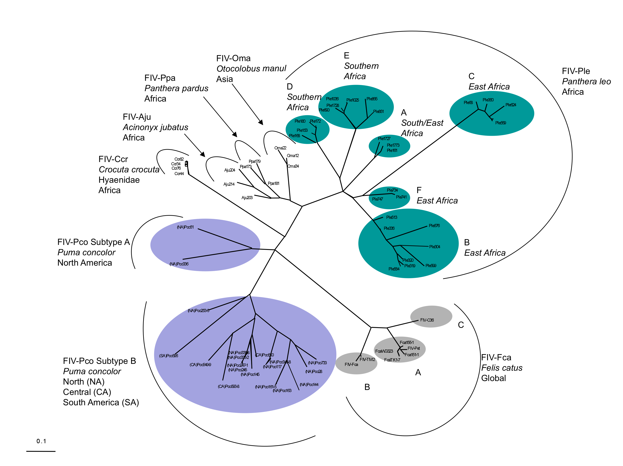
RT-Pol

